Slide 1


Ait614-Big Data Essentials-Sec001
Bridges at Risk: Coastal vs Inland Environment impacts on lifespan and maintenance
Under guidance of Dr. Lindi Liao
George Mason University
Team Members: Team 1
Saivarun Tanjore Raghavendra
Mohammed Tareq Sajjad Ali
Mano Sappa Harsha
Vasishta Chandala
Suraj Poldas
Big Data in Action

Slide 2
Introduction
Bridges are critical structures for connectivity and economic growth, with service life influenced by design, materials, traffic load, and environmental factors.
Environmental Stressors:
Coastal regions face unique weather patterns, including high humidity and salt exposure.
Inland regions experience temperature extremes and freeze-thaw cycles, accelerating structural aging.
Research Objectives:
Analyze differences in bridge deterioration between coastal and inland regions.
Apply K-means clustering to uncover condition patterns.
Develop an ensemble model (Random Forest, XGBoost, Neural Networks) to predict bridge risk levels.
Outcome:
Support transportation agencies in resource allocation, maintenance prioritization, and policy formulation for resilient bridge infrastructure.

Slide 3
Objectives
1. Investigate regional differences in bridge deterioration rates.
2. Analyze environmental impacts (e.g., temperature, precipitation, freeze-thaw cycles).
3. Cluster bridges using K-means based on condition and environmental features.
4. Develop ensemble models (Random Forest, XGBoost, Neural Networks) to predict risk levels.
5. Provide insights for maintenance prioritization and resource allocation.

Slide 4
Dataset
• Attributes:
- Structural: Bridge Age, Condition Ratings, Span Material.
- Environmental: Temperature, Humidity, Precipitation, Freeze-Thaw Cycles.
- Traffic: Average Daily Traffic (ADT), Vehicle Types.
• Size: 41 columns, 34000+ rows (in virginia)
• Source: Data - LTBP InfoBridge.
Url: https://infobridge.fhwa.dot.gov/Data/

Slide 5
Architecture/Framework
Core Framework:
Combines data preprocessing, clustering, and predictive modeling into a streamlined system for bridge analysis.
Steps in the System:
Data Preprocessing:
Handling missing values (imputation for numerical and categorical data).
Standardizing numerical features (e.g., bridge age, traffic volume).
Encoding categorical variables (e.g., one-hot encoding for location type).
Selecting key features, such as environmental conditions, traffic data, and structural properties.
Clustering:
Using K-Means clustering to group bridges into risk categories.
Determining the optimal number of clusters via the Elbow Method.
Predictive Modeling:
Developing ensemble models (Random Forest, XGBoost, Neural Networks) for risk level
prediction.
Validating models using cross-validation and feature importance analysis.

Slide 6
Data Processing & Analytics Approaches
Data Processing:
Segmentation of bridges into coastal and inland categories based on geographical data.
Feature extraction and correlation analysis to understand relationships between environmental factors and bridge conditions.
Statistical tests (e.g., T-tests, ANOVA) to compare coastal and inland bridge attributes.
Analytics Approaches:
Clustering:
Features: Average Daily Traffic (ADT), temperature, precipitation, freeze-thaw cycles, and condition ratings.
Insights: Clusters provide actionable information on bridge risk levels (e.g., high-risk vs. low-risk groups).
Predictive Modeling:
Ensemble models integrate Random Forest for feature selection, XGBoost for high predictive accuracy, and Neural Networks for non-linear relationships.
Focus on predicting bridge risk levels for prioritizing maintenance.

Slide 7
SW/HW Development Platforms
Software Platforms:
Python: Core programming for data analysis and modeling.
PySpark: Distributed data processing and clustering.
Scikit-learn: Machine learning algorithms and evaluation metrics.
Matplotlib & Seaborn: Data visualization.
Jupyter Notebook: Development environment for code and visualization.
Hardware Platforms:
Local Machines:
16 GB RAM, Intel Core i7 Processor for initial analysis.
MacBook Pro 16 (M2): High-performance machine with Apple’s M2 chip.
Cloud Platforms:
Databricks: Distributed data processing and analysis.

Slide 8

Data Collection and Preprocessing
Data Collection:
Data sourced from InfoBridge.
Data Cleaning Process:
Calculated the percentage of missing values in each column.
Columns with more than 30% missing values were handled (MCAR,MAR,NMAR), missing data was imputed appropriately.
Handling Irrelevant Data:
Identified irrelevant values in columns (e.g., location name in bridge condition).
Replaced irrelevant values with nulls and removed them.
Null Value Management:
Chose to remove null values since the dataset size is large, minimizing impact on the analysis.

Slide 9
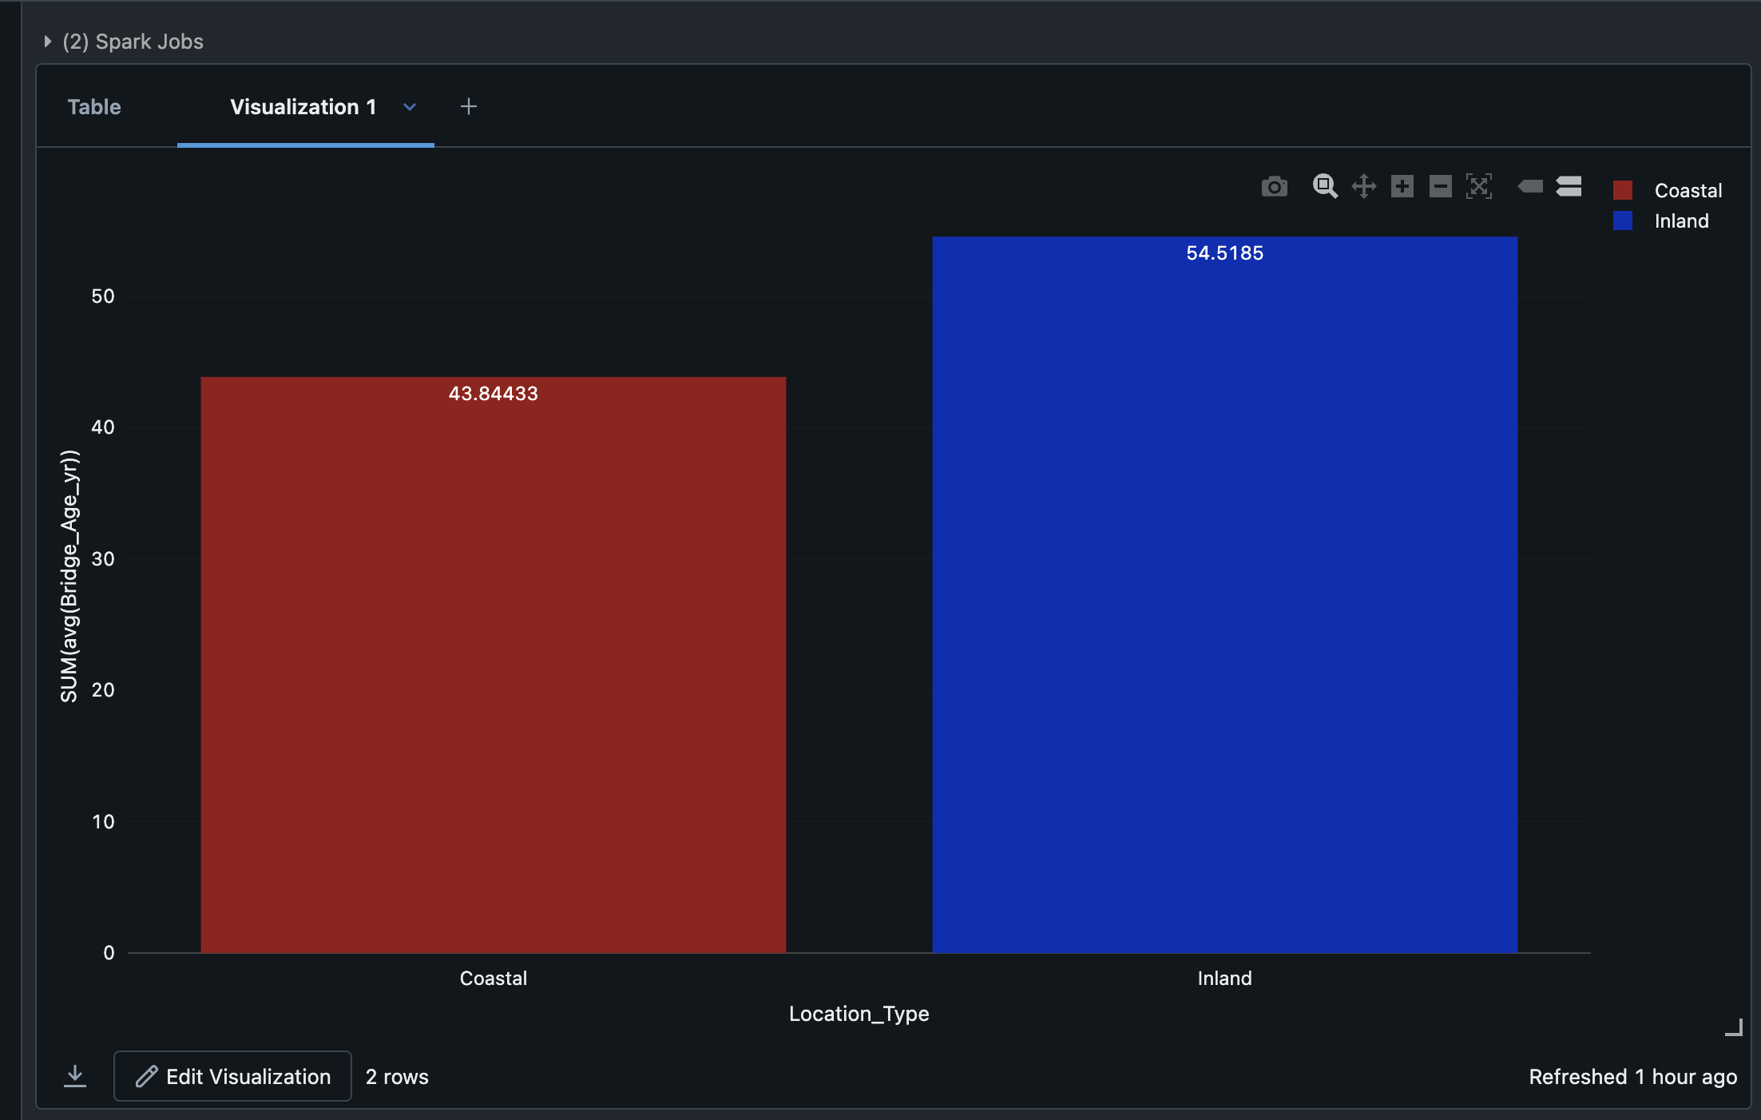
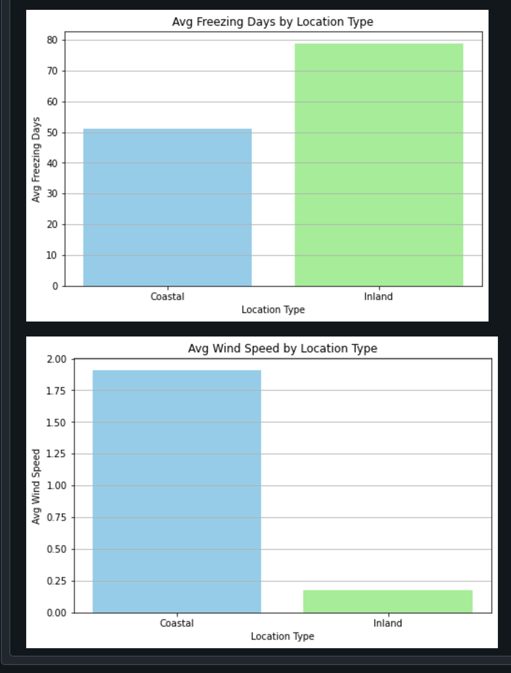
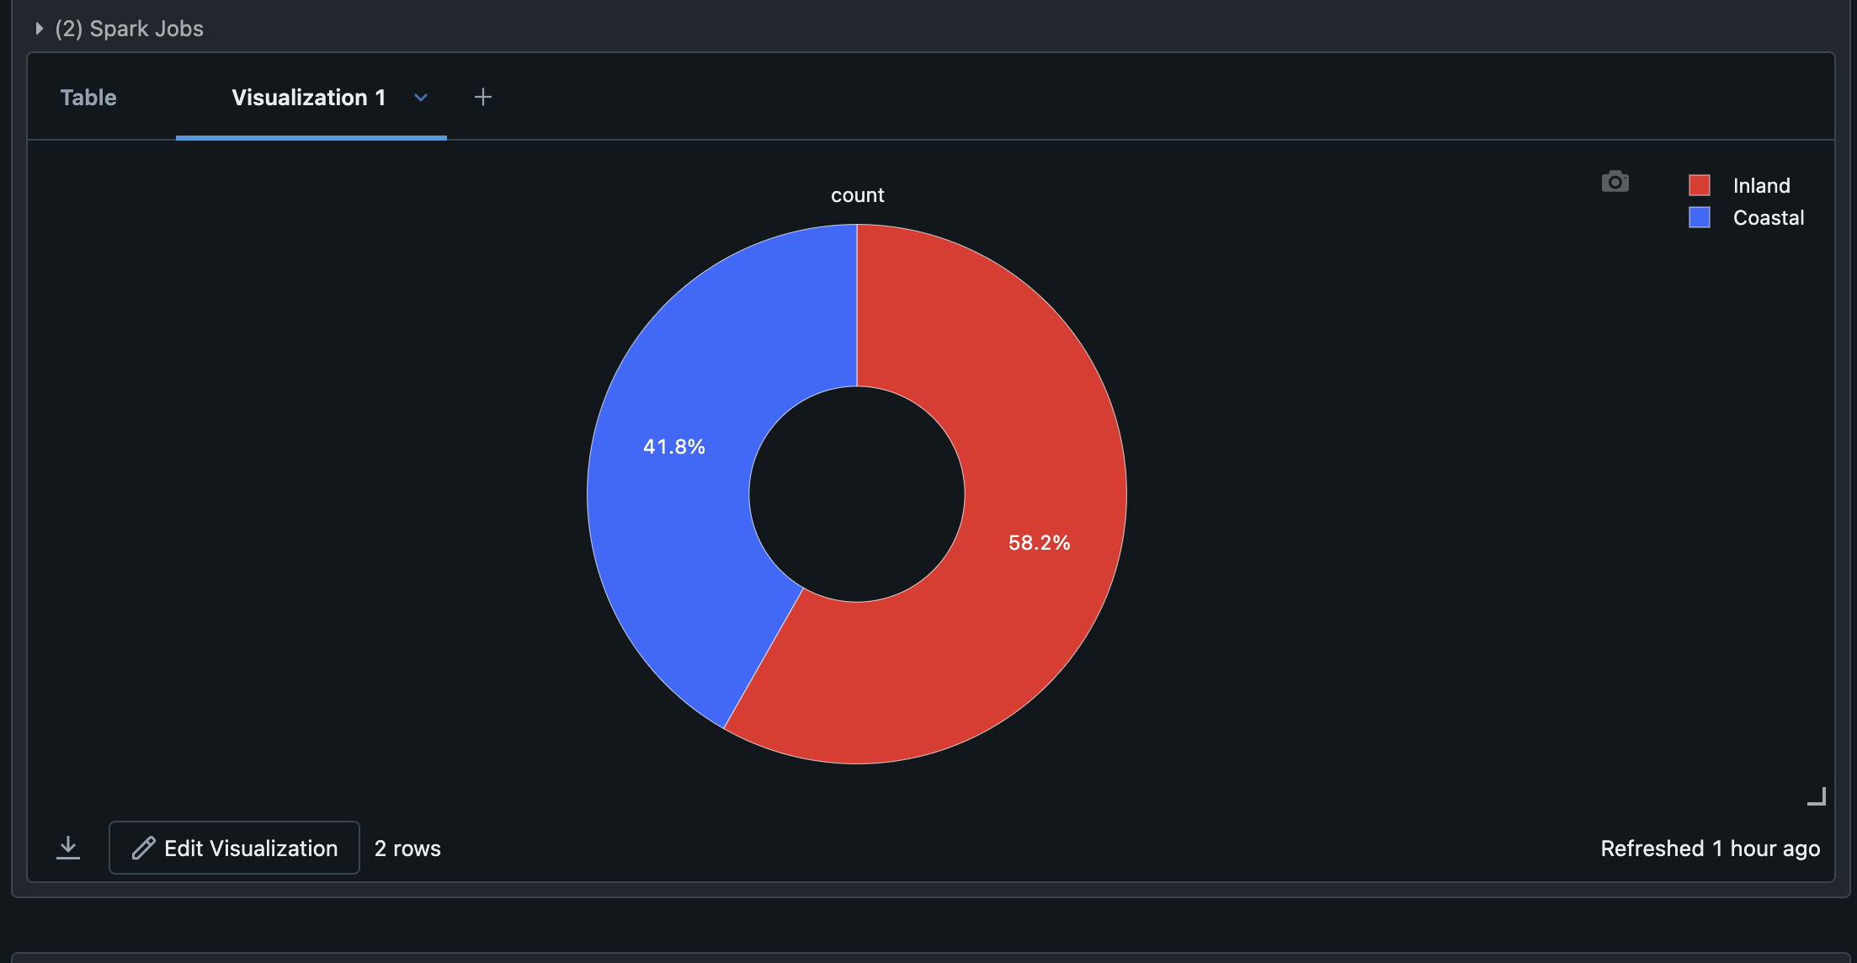
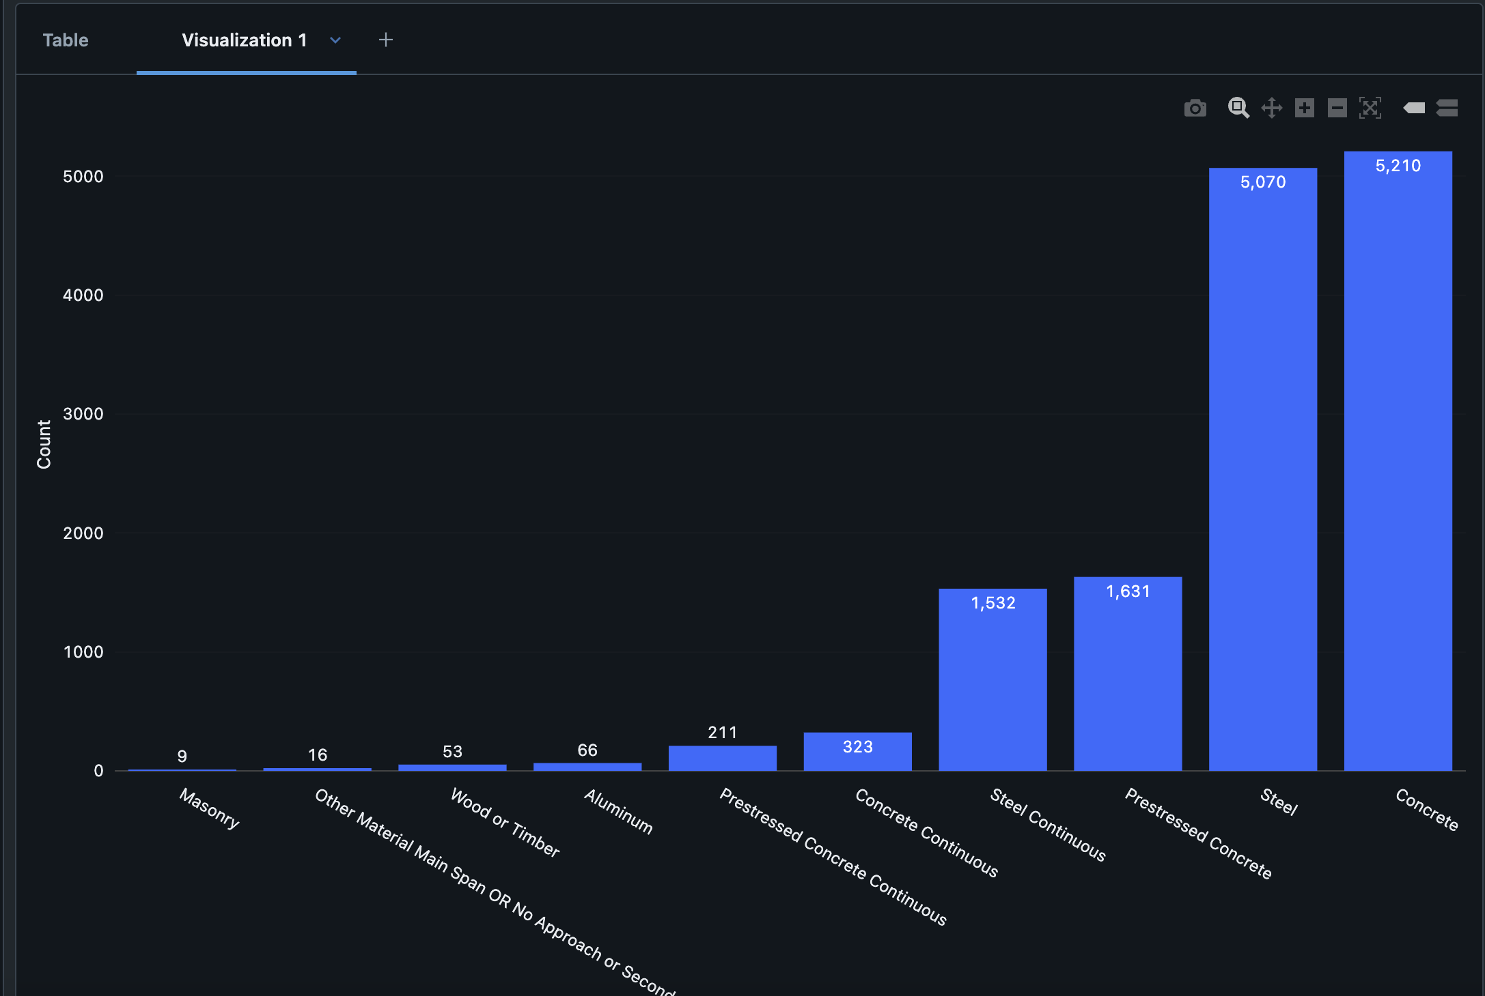
Data Exploration (EDA)

Slide 10
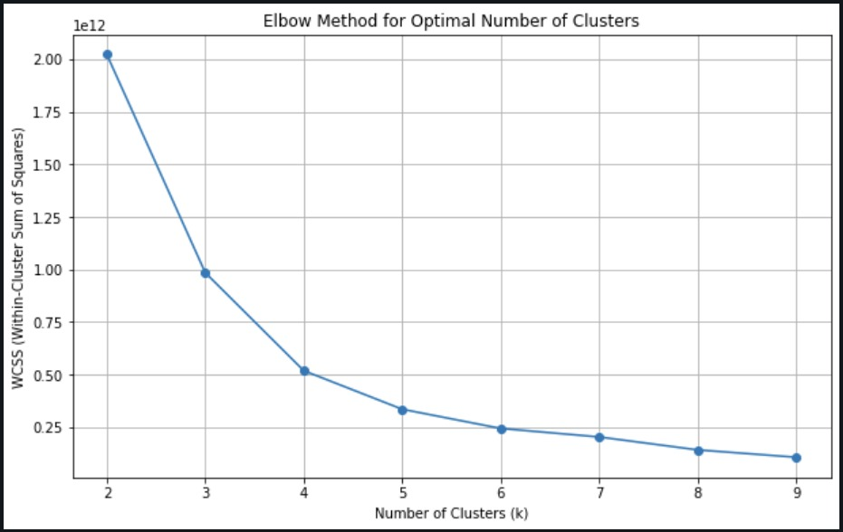
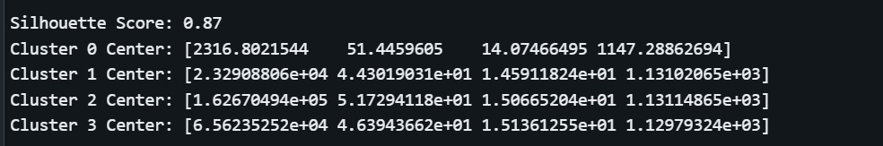
Data Modelling
Elbow Method:
Optimal Number of Clusters:
The Elbow method identifies 4 clusters as the optimal number, where the decrease in WCSS slows significantly, indicating diminishing returns in cluster variability.
Cluster Centers Insights:
Cluster 0:
Represents bridges with lower feature values (e.g., traffic, age, environmental conditions).
Likely lower risk or maintenance requirements.
Cluster 1:
Moderate values across environmental and bridge characteristics.
Indicates moderate risk or maintenance needs.
Cluster 2:
Higher values for temperature and precipitation.
Represents high-risk bridges requiring frequent maintenance.
Cluster 3:
Highest values for all features, representing very high-risk bridges needing priority attention.
Silhouette Score:
Score: 0.87, indicating well-defined and separated clusters.
Implications:
Bridges in Clusters 2 and 3 should be prioritized for maintenance and monitoring due to their high-risk characteristics.
Clusters 0 and 1 can follow a routine maintenance schedule, reducing resource strain.

Slide 11
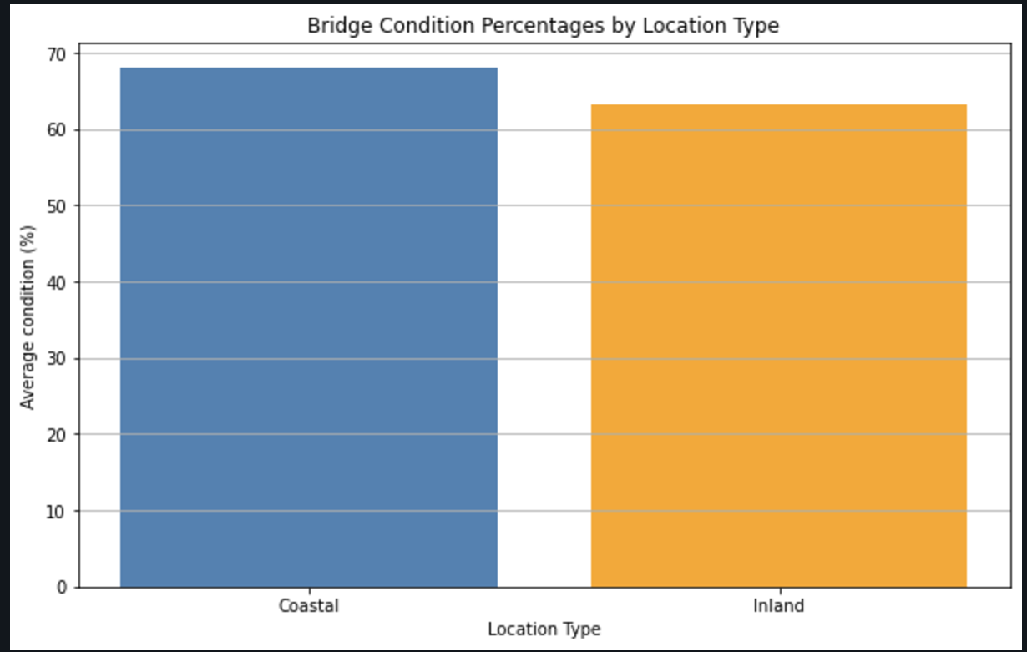
Results and Findings
Average Bridge Condition by Location Type:
Findings:
The average condition score for coastal bridges is 1.297, while for inland bridges, it is slightly lower at 1.286.
Coastal bridges show marginally better conditions compared to inland bridges.
Interpretation:
Inland bridges may require more frequent maintenance due to environmental challenges like freeze-thaw cycles and temperature extremes. These conditions accelerate structural fatigue, leading to cracking and wear over time.
Coastal bridges, despite exposure to humidity and salt, appear to be in relatively better condition. Regular upgrades and corrosion-resistant materials have contributed to their improved ratings.
Notes:
Based on the analysis of the dataset, we calculated the average bridge condition for both coastal and inland regions. The numeric average condition score for coastal bridges was 1.297, while for inland bridges, it was 1.286. This indicates that coastal bridges tend to have slightly better overall conditions compared to inland bridges. A bar plot visually reinforces this observation, showing that the inland bridges have a slightly lower average condition score compared to the coastal ones. This could imply that inland bridges may face more maintenance challenges over time. Further analysis could involve breaking down the condition score by individual factors, such as age and environmental conditions, to gain deeper insights into maintenance needs.

Slide 12
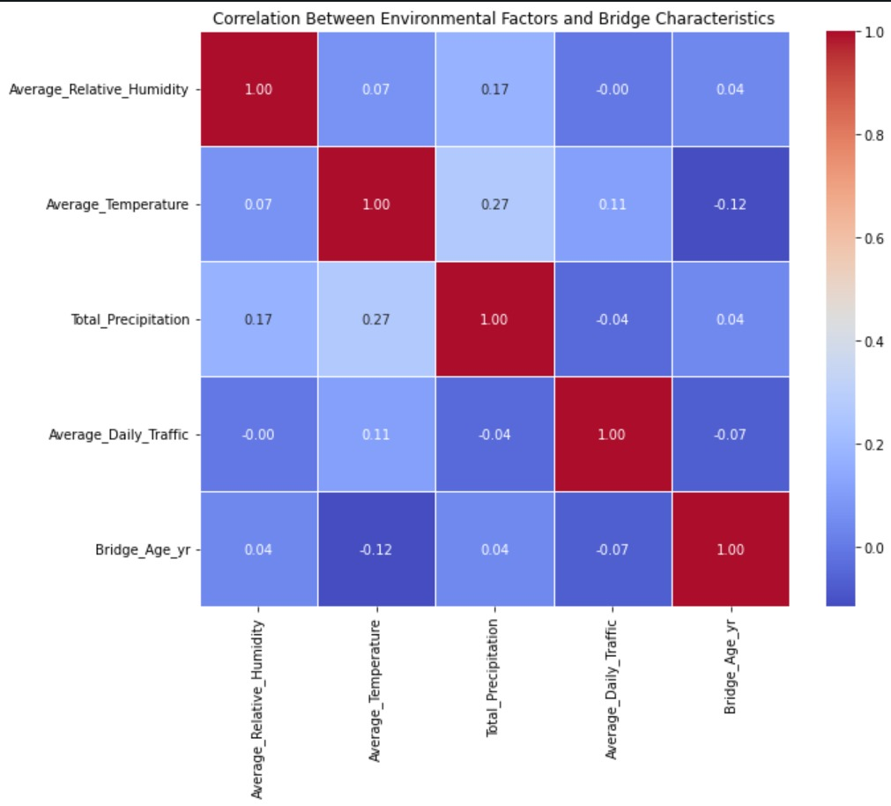
Correlation Between Environmental Factors and Bridge Characteristics:
Average Relative Humidity:
Weak positive correlation with Total Precipitation (0.17).
Negligible correlation with Temperature (0.07), Traffic (-0.00), and Bridge Age (0.04).
Average Temperature:
Moderate positive correlation with Total Precipitation (0.27).
Weak correlation with Traffic (0.11) and negligible correlation with Bridge Age (-0.12).
Total Precipitation:
Moderate positive correlation with Temperature (0.27) and weak correlation with Humidity (0.17).
Negligible correlations with Traffic (-0.04) and Bridge Age (0.04).
Average Daily Traffic:
Slight correlation with Temperature (0.11) and negligible impact on Bridge Age (-0.07).
Bridge Age:
Minimal correlation with environmental factors, implying age is more influenced by maintenance, structural design, and traffic load.

Slide 13
Project Evaluation
Clustering Evaluation:
Silhouette Score: Achieved a high score of 0.87, indicating well-defined clusters.
Applied PCA for visualization in both 2D and 3D.
Predictive Model Evaluation:
Classification Report: Evaluated using Accuracy, Precision, Recall, and F1-score.
Models used:
Random Forest: Feature importance highlights key factors like Bridge Age and Traffic Volume.
XGBoost: Demonstrated strong predictive capabilities with parameter tuning.
MLP (Neural Network): Tuned for optimal hidden layers and iterations.
Statistical Analysis:
Performed T-Tests to compare Coastal vs. Inland bridge characteristics.
Correlation Analysis: Identified moderate correlations between environmental factors and bridge conditions.

Slide 14
Insights
Key Findings from Evaluation:
- Clusters with older bridges, high traffic, and adverse environmental factors are at higher risk and require immediate maintenance.
- Coastal bridges show better overall condition despite environmental stressors due to proactive maintenance.
Inland bridges are older, facing more extreme freeze-thaw conditions.
Insights:
- Bridges in Cluster 3 are the highest priority for maintenance as they experience high temperatures, high humidity, heavy daily traffic, and are older structures.
- Bridges in Cluster 2 are the next priority, characterized by high temperatures and significant precipitation levels.
- Bridges in Cluster 1 follow, with moderate temperatures and being relatively younger.
- Bridges in Cluster 0 are the lowest priority since they are recently built and exhibit less risky characteristics.

Slide 15
Conclusions
This study integrates data preprocessing, clustering, and predictive modeling to evaluate environmental impacts on bridge conditions.
Outcomes:
- Provided a framework for risk prediction.
- Supported resource allocation and maintenance prioritization.
- Contributed to resilient and sustainable infrastructure development.

Slide 16
Acknowledgment
Dr. Lindi Liao:
We deeply thank our professor for her guidance and support throughout this project. Her expertise and valuable advice made a significant difference.
Ravi Rachuri:
A special thanks to our teaching assistant for addressing technical questions and providing immense support for the project.
George Mason University:
We acknowledge the university for its resources and support that facilitated this research.
Federal Highway Administration:
We appreciate the invaluable data provided, which was crucial to our work.
Family and Friends:
We thank our loved ones for their continued support and encouragement during this journey.
This project has been a wonderful learning experience, and we are grateful to everyone who contributed to its success.

Slide 17
References
Data - LTBP InfoBridge. (n.d.). https://infobridge.fhwa.dot.gov/Data/
Ph.D., J. M., & Kavlakoglu, E. (2024, August 15). What is ensemble learning?. IBM. https://www.ibm.com/topics/ensemble-learning#:~:text=Ensemble%20learning%20is%20a%20machine,than%20a%20single%20model%20alone/
American Institute of Steel Construction (AISC). "Steel Bridge Design Handbook." https://www.aisc.org/nsba/design-and-estimation-resources/steel-bridge-design-handbook/.
Neumann, J. E., Price, J., Chinowsky, P., Wright, L., Ludwig, L., Streeter, R., Jones, R., Smith, J. B., Perkins, W., Jantarasami, L., & Martinich, J. (2014). Climate change risks to US infrastructure: impacts on roads, bridges, coastal development, and urban drainage. Climatic Change, 131(1), 97–109. https://doi.org/10.1007/s10584-013-1037-4
Correlations Between Sets of Data for Investigating Bridge Conditions in Virginia. (2024). ScholarSpace. https://scholarspace.library.gwu.edu/concern/gw_etds/5x21tg31d

Slide 18

By Team 1

